Slide 1
Dimensionality Reduction Advanced Machine Learning
Data Science at Zindua School | By Chris Aloo

Slide 2
Topic Coverage
Week 1 Dimensionality Reduction : PCA, TSNE
Week 2 Clustering : Kmeans, Hierachical, Density Clustering, GMM
Week 3 TimeSeries : TSA and Time Series Models
Week 4 Deep Learning Foundations : MLP, CNN, RNN, GAN, Autoencoders
Week 5 End of Module Project

Slide 3
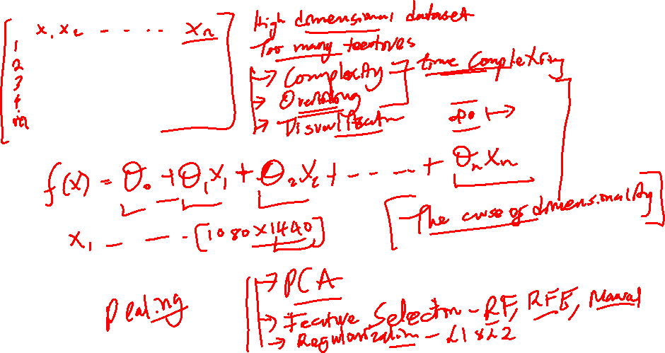

Slide 4
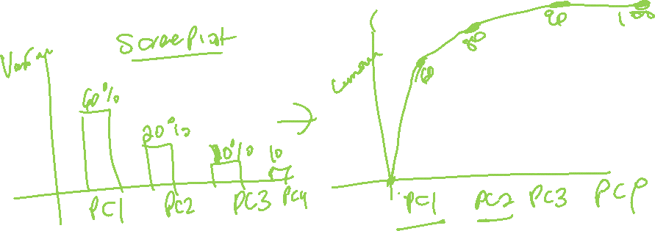

Slide 5
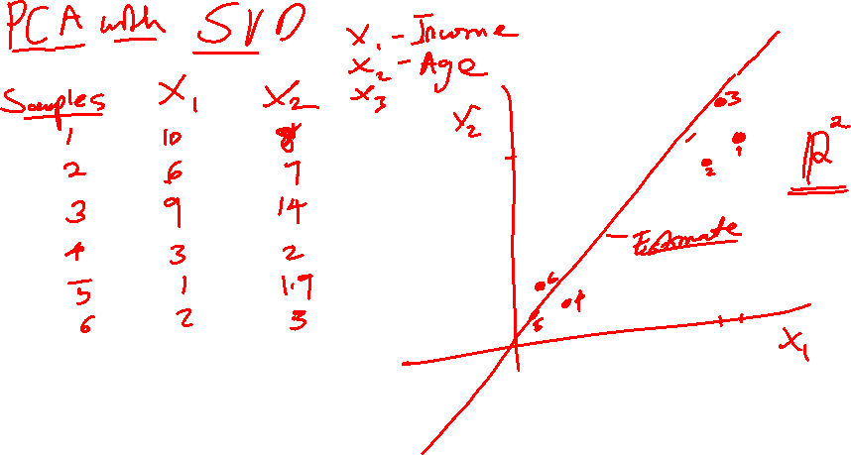

Slide 6
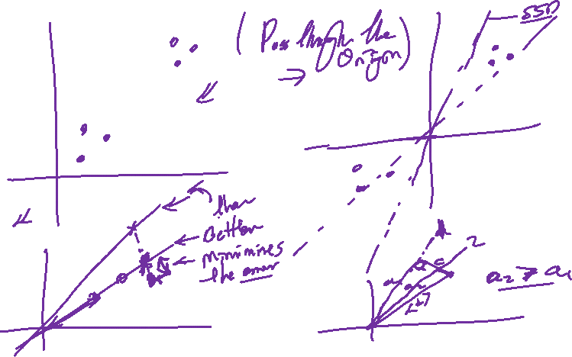

Slide 7
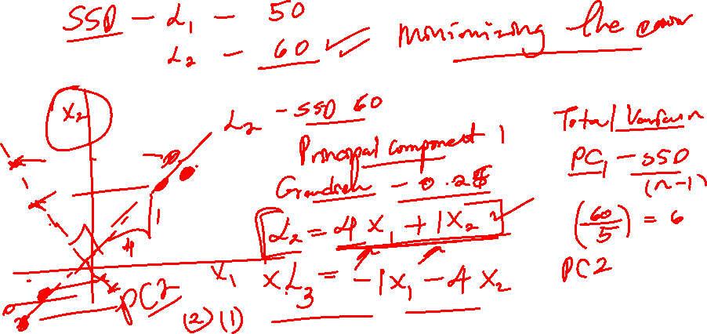

Slide 8
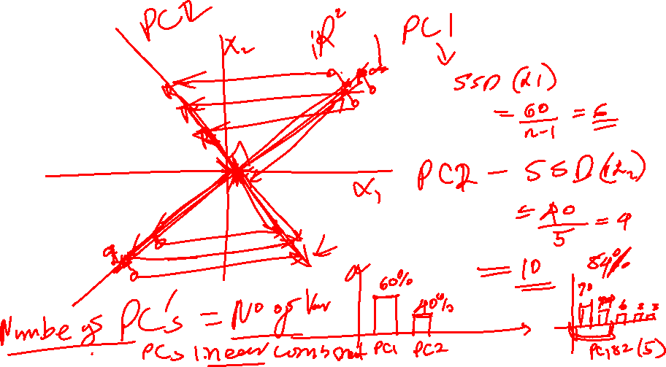

Slide 9
End…

